Slide 1

5th Floor, Usnaz Tower, Church Landing Rd, near Medical Trust Hospital, Pallimukku, Kochi, Kerala 682016

Slide 2
Decision Making Statement

Slide 3
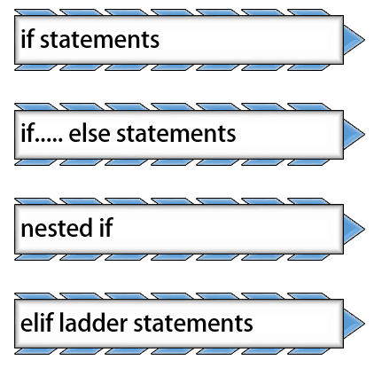

Slide 4
These are logical decisions, and Python also provides decision-making statements that to make decisions within a program for an application based on the user requirement. It consists of a Boolean expression which results are either TRUE or FALSE, followed by one or more statements.

Slide 5
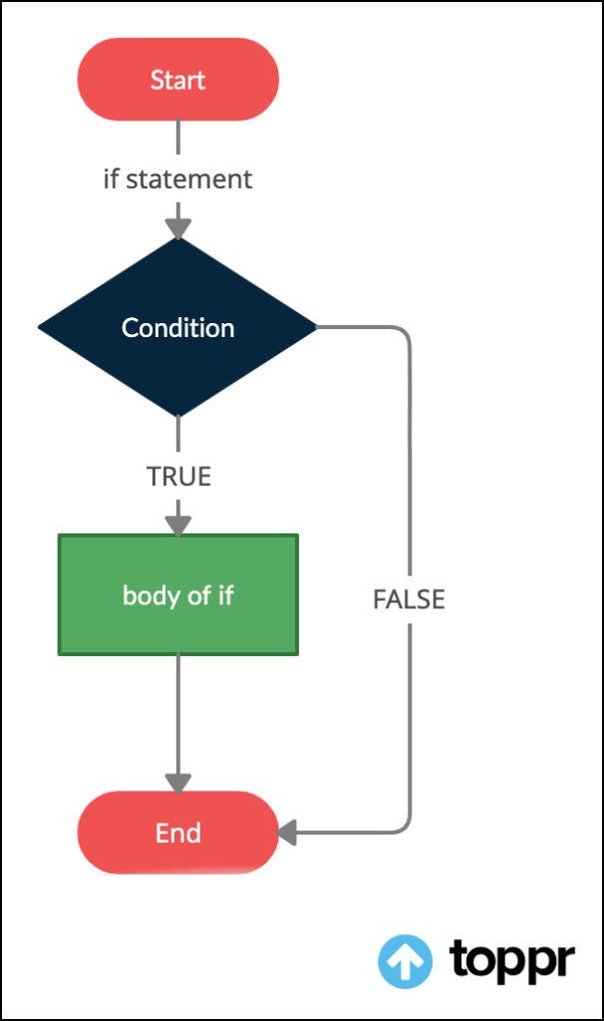
If statement
"if" statement: The "if" statement allows the program to execute a block of code if a certain condition is true

Slide 6
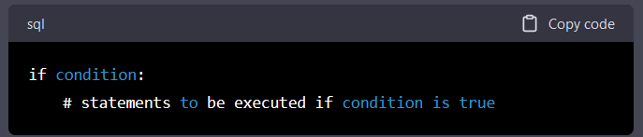
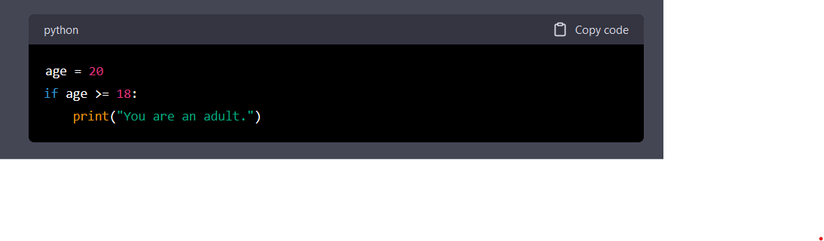

Slide 7
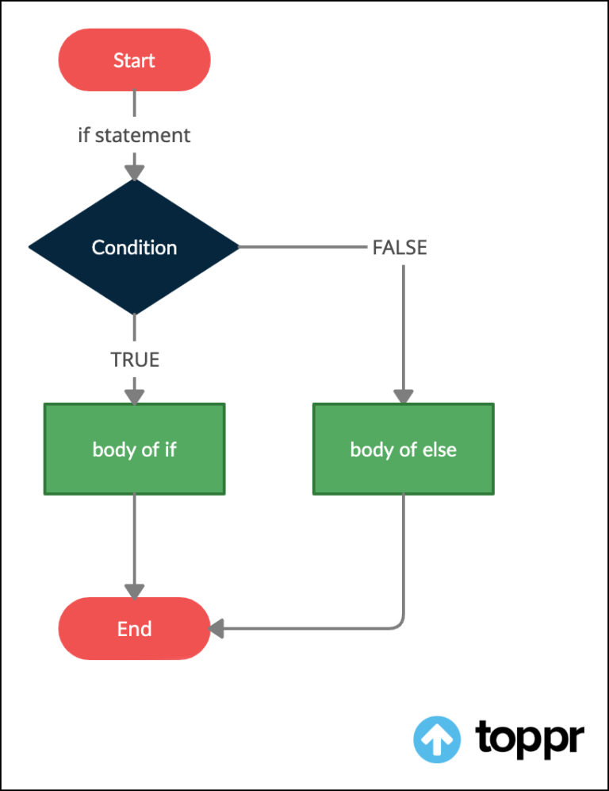
If – else statements
"if-else" statement: The "if-else" statement allows the program to execute one block of code if a condition is true and another block of code if the condition is false.

Slide 8
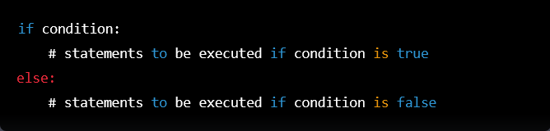

Slide 9
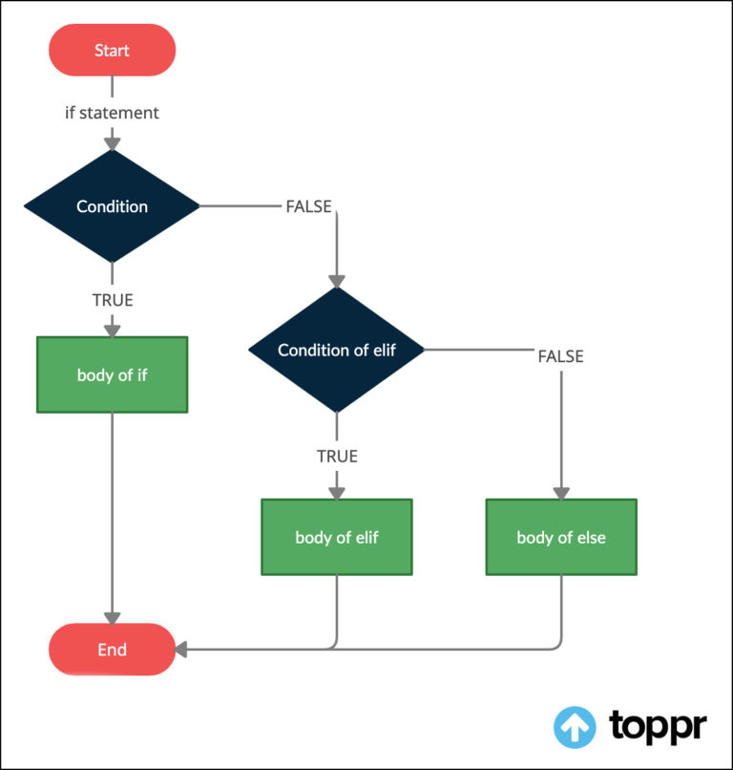
Elif
Elif is a keyword in Python that stands for "else if". It is used to add additional conditions to an if statement, allowing you to test multiple conditions.

Slide 10
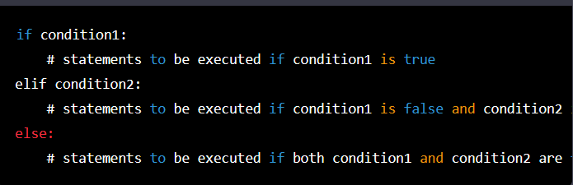
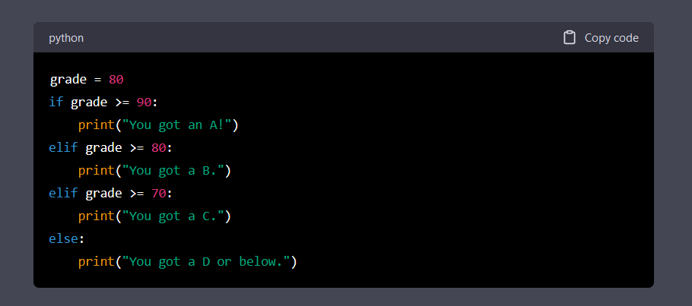


Slide 11
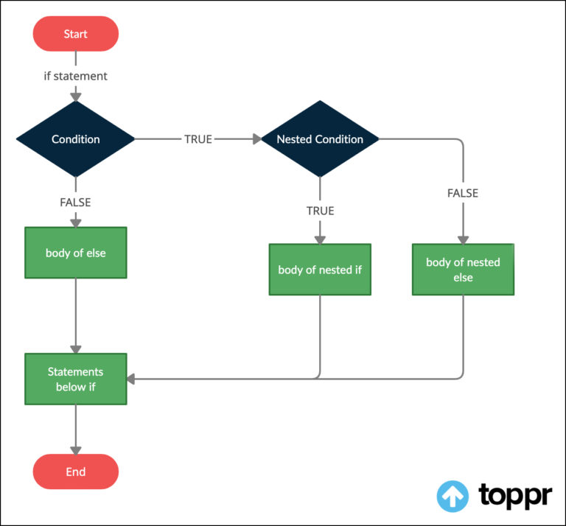
Nested if
Nested if statement: A nested if statement is an if statement that is nested inside another if statement. It is used when you need to test multiple conditions. The syntax of a nested if statement is as follows:

Slide 12
